Slide 1
Predicting S&P500 Index Based on Consumer-related Indicators
ANLY 502 Project Report
Group 1: Abdul Hai Hazari; Ashok Kumar Aalla; Fan Jiang; Léa Demri

Slide 2
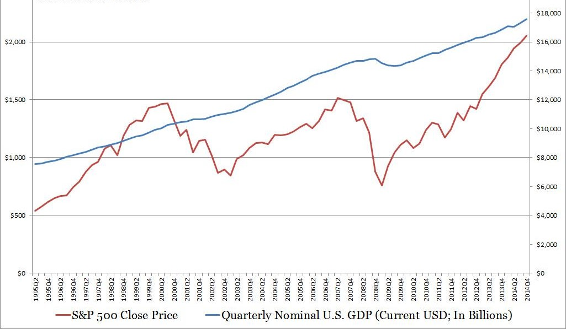
Introduction and Data Description
The Stock market is a major indicator of a country’s Economic Health
2008 Financial Crisis U.S. GDP shrank of 6.2%
Starting 2010, The U.S. economy has entered the longest expansion in history.
Year on year GDP growth around 2%. Unemployment Rate Lower than 4%.

Slide 3

Multilinear Regression Model
Research question: Can an ordinary consumer benefit from the current economic boon ?
i.e. Can we use consumer-related indicators to predict stock market movement?
The Null hypothesis is H₀: β₁₌ β_{2=…} β₉=0
The Alternative hypothesis is H₁: β_{1~} β₉≠0
Model 1 / Original Model:
$I\hat{ndexPrice(monthly})$=β₀ + β₁Personal Consumption Expenditure+ β₂Medicare + β₃Personal Interest Income+ β₄Personal Dividend Income+ β₅Real Disposable Personal Income+ β₆Personal Savings Rate+ β₇Personal Interest PMT+ β₈Personal Current Taxes+ β₉Social Security+ $ε$

Slide 4
Introduction and Data Description
The Chosen X Independent Variables:
Personal Consumption Expenditure ($ Billion)
Medicare ($ Billion)
Personal Interest Income($ Billion)
Personal Dividend Income ($ Billion)
Real Disposable Personal Income($ Billion)
Personal Savings Rate %
Personal Interest PMT ($ Billion)
Personal Current Taxes ($ Billion)
Social Security ($ Billion)
The Chosen Dependent Y variable:
S&P 500 Index Monthly Adjusted Price
-All are numerical variables
-Data Range from
1980 Jan-2019 Sep

Slide 5

Assumptions on the Regression Model
Multivariate linearity The independent variables have a significant and observable impact on the monthly S&P 500 adjusted closing price. This relationship is assumed to be linear and subject to random error.
Variance in all predictors All the independent variables vary.
Multivariate normality The residuals are normally distributed: $ε_{i}∼N\left(0, σ^{2}\right), i = 1, …, n$.

Slide 6

Assumptions on the Regression Model
Independence in the values of the residuals Our observations must be independent from one another: ${(ε}_{1}, …, ε_{n})$ are mutually independent.
Homoscedasticity The variance of error terms is constant across the values of the independent variables: ${Var(ε}_{i})=σ^{2}, i = 1, …, n.$
No influential cases biasing our model Significant outliers and influential data points can place undue influence on the model, making it less representative of the data as a whole.
The S&P 500 index is a good proxy for the stock market.

Slide 7
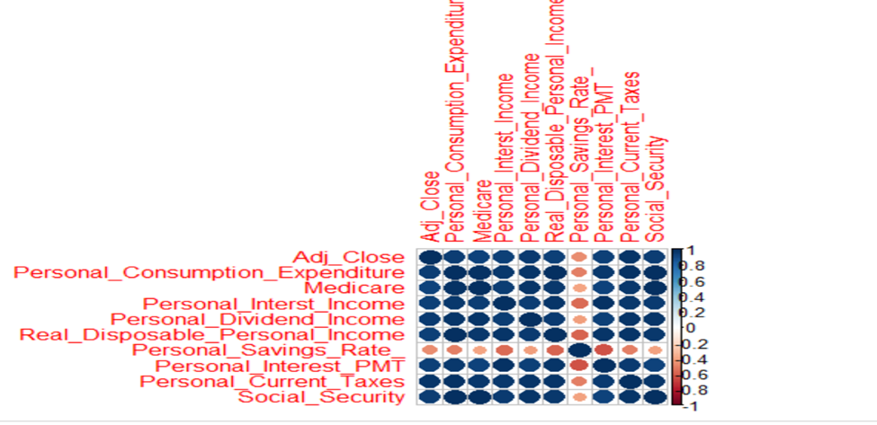
Assumptions on the Regression Model
Additivity / No multicollinearity Most of our independent variables are correlated with each other. This is a limitation of our dataset. Most variables except Personal_Savings_Rate have a strong correlation > 0.9.

Slide 8
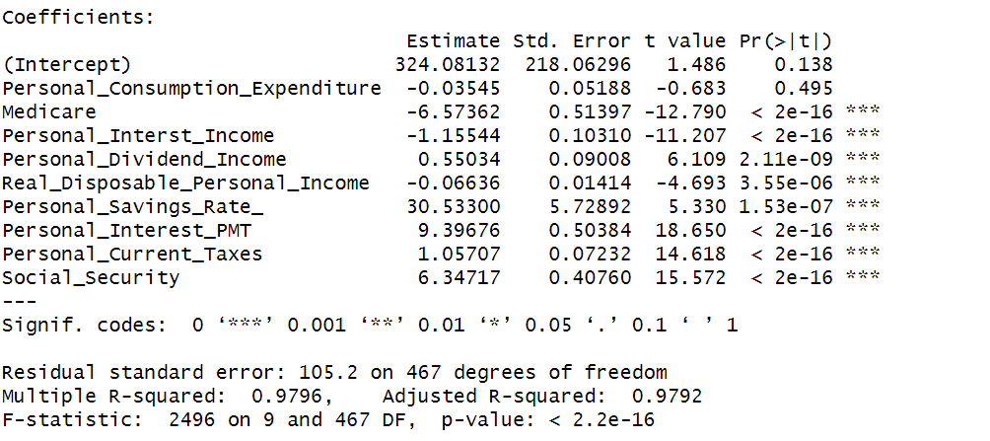
The findings and our interpretation Model 1:
Insignificant

Slide 9

The Improved Model
Drop Variable: Personal consumption Expenditure
New Model:
$\hat{IndexPrice(monthly})$=β₀ + β₁Medicare + β₂Personal Interest Income+ β₃Personal Dividend Income+ β₄Real Disposable Personal Income+ β₅Personal Savings Rate+ β₆Personal Interest PMT+ β₇Personal Current Taxes+ β₈Social Security+ $ε$

Slide 10
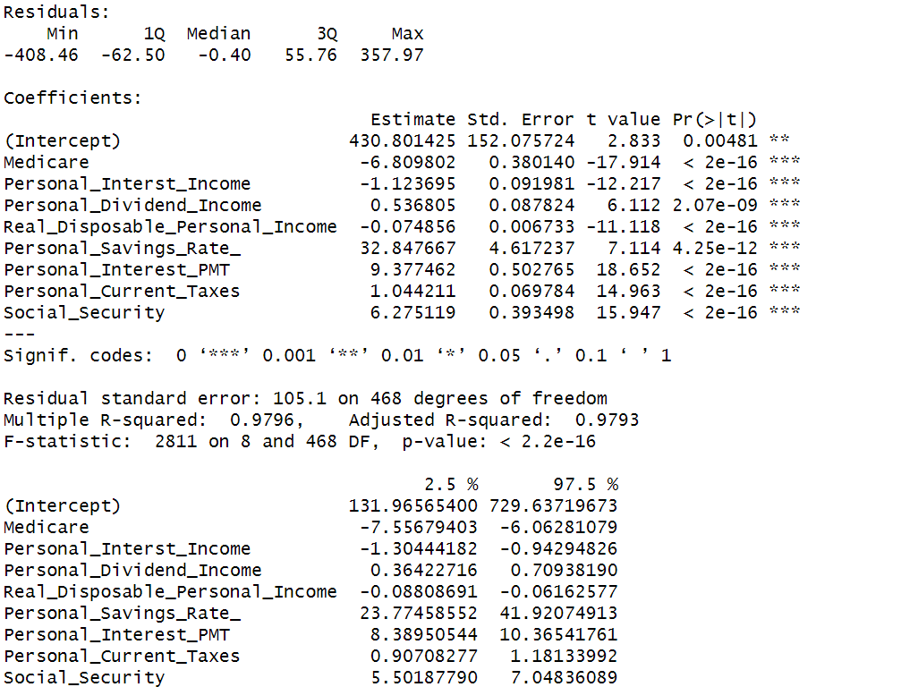
Our Optimal Model

Slide 11
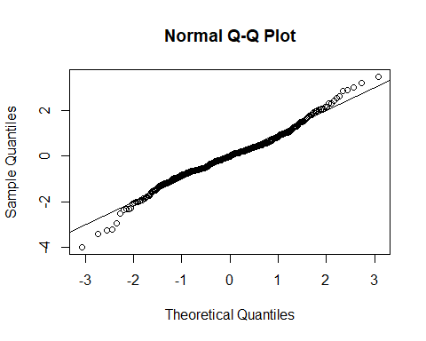
Verifying the Assumptions on the Optimal Regression Model
Multivariate linearity The assumption for linearity is met since the Normal Q-Q plot is nearly linear.
Model 2

Slide 12
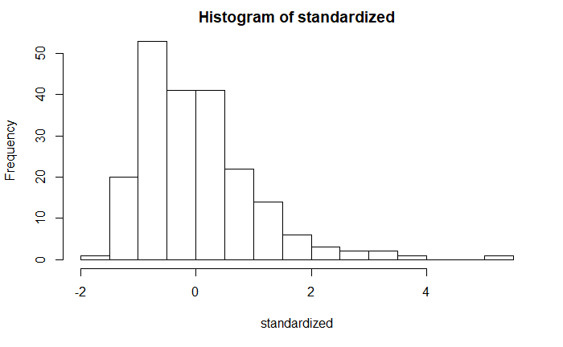
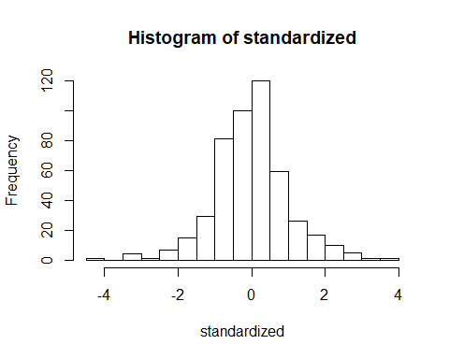
Verifying the Assumptions on the Optimal Regression Model
Multivariate normality The assumption for normality is met since the histogram presents a nearly normal distribution.
Model 2
Model 1

Slide 13
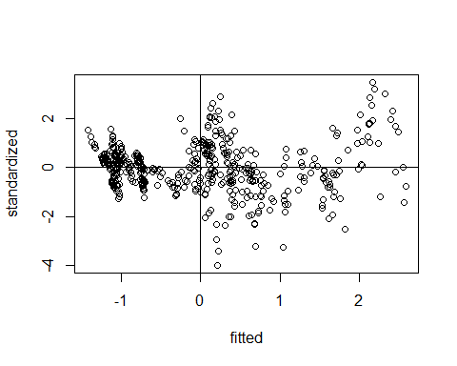
Verifying the Assumptions on the Optimal Regression Model
Homogeneity The assumption for homogeneity is met since the plot shows that the spread is nearly consistent across the ranges of values.
Homoscedasticity The assumption for homoscedasticity is met since the variance around the regression line is similar for all values of the predictor variable.
Model 2

Slide 14

Conclusion
$\hat{IndexPrice(monthly})$=$430 -6.8*Medicare -1.12*Personal Interest Income+ 0.53*Personal Dividend Income-0.07*Real Disposable Personal Income+ 32.8*Personal Savings Rate+ 9.37*Personal Interest PMT+ 1.04*Personal Current Taxes+ 6.27*Social Security+ $ε$
The movements of consumer-related indicators in our model are highly correlated with the monthly price change of S&P 500 index.

